Slide 1

Book Management System
Mini project using oracle applications

Slide 2
ORA-TECHMATES Mentor - Devangana Mandal Trainer - Sachin Narendekar
Employee Id | Employee Name | Role | Contribution
129078 | M.S.Sai Akhil | Team Lead | Table Scripts, SQL loader
129065 | V.Abhishikth | Team Member | PL/SQL Validations, Documentation
129067 | G.Sai Saranya | Team Member | Forms, Validations
129071 | M.Narmada | Team Member | Master Form, Oracle Applications
129069 | Syed Manshad | Team Member | Report, Oracle Applications
129070 | M.Pavani | Team Member | Report, PPT, Validations

Slide 3
contents
Introduction
Work Flow
Requirement Analysis
SQL Loader
Forms,
Reports
Conclusion

Slide 4
Introduction
The aim of our project is to develop a Book Management System for the Company ‘ABC Computers’.
Actions to be performed with the system:
1.Search for Books
2.Add the Books
3.Add the Authors
4.Remove the Books

Slide 5
Work FLow
Requirement Analysis
Tables Creation
SQL Loader
Validations
Forms
Reports
Oracle Applications
0000000000000

Slide 6
Requirement Analysis
Author Table Creation
Book(Dummy) Table Creation
Data Loading Using SQL Developer
PL/SQL (Validations)
Author Form Creation
Book Master Form Creation
Report Generation

Slide 7


Table Creation
AUTHOR TABLE
STAGING TABLE
BOOK TABLE
ERROR TABLE
AUTHOR TABLE
BASE TABLE
BOOK TABLE

Slide 8
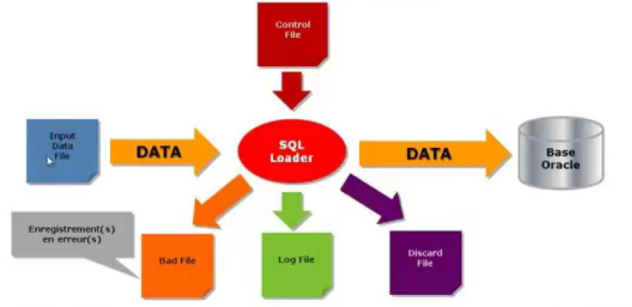
Sql loader
Authors Stage
1.Control File
2.Data File
Books Stage
1.Control File
2.Data File

Slide 9

validations
AUTHOR TABLE
Trim(spaces & tabs)
Author_ID
Gender
BOOK TABLE
Book_ID
Author_ID
ISBN code
Size,Cost
Book Type
CODE

Slide 10

forms
FORMS
Author form
Book masters form
o

Slide 11
Oracle applications
Form registration
Create a function for the form
Assign the function to the Custom Menu
Custom Menu should be assigned to the Responsibility
Assign the responsibility to the TEST USER

Slide 12

report
Object Navigator
Output File
Data Model
Report Layout
No data found
Generated Report
End of the report

Slide 13
Conclusion
In this project we developed the system for Book Management
which includes SQL loader, reports and forms by using Oracle
Applications.

Slide 14
FUTURE SCOPE
Data-Filtration Based on book-type using Check-Box or Radio Buttons
FORM WITH RADIO BUTTONS

Slide 15
THANK YOU

